Slide 1

PCI DSS Toolkit Enterprise Standards for Information Security – IE3102
Senarathna K.M.G.S.B
IT19118932
Y3S2

Slide 2

PCI DSS Introduction
The Payment Card Industry Data Security Standard (PCI DSS) is a set of security standards formed in 2004 by Visa, MasterCard, Discover Financial Services, JCB International and American Express.
PCI DSS compliance scheme aims to secure credit and debit card transactions against data theft and fraud.
Is governed by the Payment Card Industry Security Standards Council (PCI SSC)
PCI DSS is a requirement for any business that processes credit or debit card transactions.

Slide 3

Why PCI DSS ?
Is mainly implemented as a mitigation to reduce payment card fraud and to protect payment card holder data by organizations.
Such incidents can lead to,
Fines and legal penalties
Lost client confidence
Reputational loss
Additional cost of reissuing new payment cards
Bankruptcy

Slide 4

Implementation checklist for PCI DSS
Goals:
Building and maintaining a secure network and systems
Protect cardholder data
Maintain a vulnerability management program
Implement strong access control measures
Monitor and test networks periodically
Maintain an information security policy

Slide 5
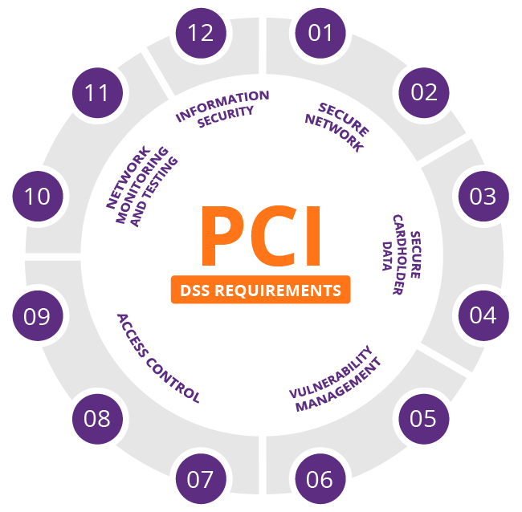

Slide 6
12 requirements to achieve PCI DSS compliance
Install and maintain a firewall configuration to protect cardholder data
Do not use vendor-supplied defaults for system passwords and other security parameters
Protect stored cardholder data
Encrypt transmission of cardholder data across open, public networks
Use and regularly update anti-virus software or programs
Develop and maintain secure systems and applications
Restrict access to cardholder data by business need to know
Assign a unique ID to each person with computer access
Restrict physical access to cardholder data
Track and monitor all access to network resources and cardholder data
Regularly test security systems and processes
Maintain a policy that addresses information security for all personnel

Slide 7
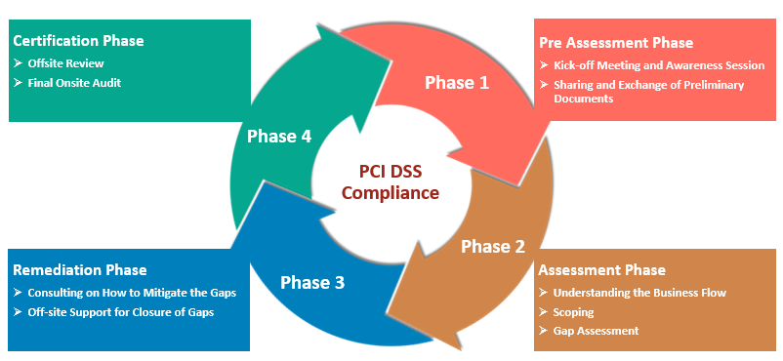
Toolkit
The toolkit contains the complete guidance for implementing PCI DSS in an organization by achieving the goals mentioned in the checklists

Slide 8
PCI DSS Implementation steps

Slide 9
Context establishment
Prior to start implementation of PCI DSS, context establishment and defining scope must be done.
There are 3 main categories of scoping when implementing PCI DSS.
PCI DSS scoping contains
People scoping
Process scoping
Technology scoping

Slide 10
Creation of the Asset inventory
Prior to finalizing the scoping phase, an Asset inventory must be created to identify specific assets that need to be secured regarding PCI DSS.
All implementation related employees should have a proper idea on all the assets in the scope.
In toolkits, an asset registry or an asset inventory is provided.

Slide 11
Risk Analysis
A risk analysis must be done in order to identify current security capability of the organization’s systems
Risk analysis contains
Creation of asset profiles
Identify threats
Implement countermeasures for identified risks

Slide 12
Gap Analysis
A Gap analysis is done in order to identify and compare current security posture of the organization and to determine the success rate of newly implemented security controls

Slide 13
Information security policy
Information security policy is implemented to define user behavior and security of systems against malware and other identified/unidentified threats
Some of the requirements such as Network segmentation can be achieved empowering the information security policy

Slide 14
Continuous monitoring and logging
In order to identify incidents and to increase visibility over critical assets that manages card holder data, continuous monitoring and incident logging is necessary.
Even after implementation, Monitoring logs using a secure operations center is recommended.

Slide 15

End.

